Slide 1
VANAPALLI SUMANTH
PREDICTING MOVIE SUCCESS

Slide 2

INDEX
Introduction
Problem Statement
Project Benefits
Data Exploration
Importing Dataset and Libraries
Categorizing the Target Variables
Handling Missing Values
Label Encoding
Correlation
Classification Model Building
Train Test Split
Scaling
Feature Selection using RFECV
Random Forest
Confusion Matrix
Classification Report

Slide 3

Title
Steps For Movie Success prediction
Load and explore the dataset using pandas, matplotlib, and seaborn.
Preprocess the data, including handling missing values, label encoding, and addressing multicollinearity.
Implement feature selection.
Split the data into training and testing sets, and apply feature scaling.
Train and evaluate a Random Forest classifier for predicting movie success categories.
Generate and interpret performance metrics and visualizations.

Slide 4


Predicting Movie Success
To develop a comprehensive data analysis pipeline and a robust machine learning model to accurately predict movie success categories (Hit, Average, Flop) based on various movie attributes. By utilizing this model, the studio aims to improve movie production decisions, marketing strategies, and overall film industry insights.

Slide 5

Project Benefits
Production Optimization: The model will help identify factors influencing movie success, allowing for more informed decisions in movie production.
Marketing Strategy: Accurate prediction of movie success can assist in tailoring marketing efforts and budget allocation.
Industry Insights: Understanding success patterns can
guide future trends and innovations in filmmaking.

Slide 6
Data Exploration (Exploratory Data Analysis) Series of Steps
Data Collection
Data Exploration
Categorizing the target variables
Handling the missing values

Slide 7
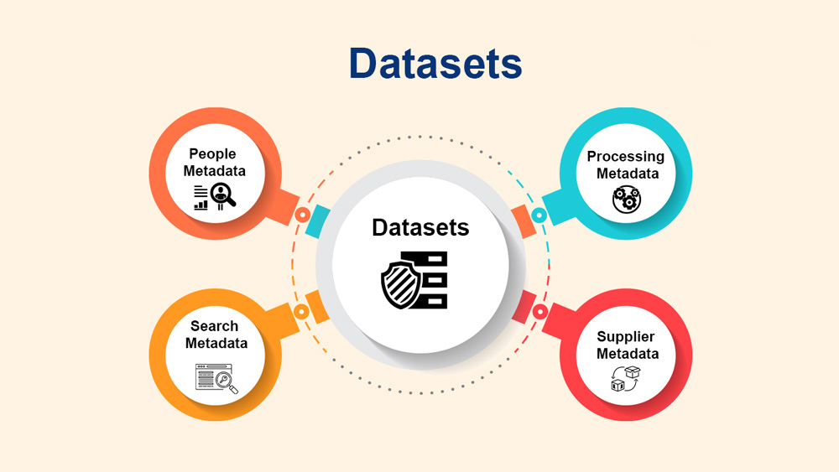
Importing the Dataset and Libraries:
Importing all the required libraries for preprocessing i.e. pandas, NumPy, seaborn and matplotlib. Importing the dataset given by the client to the notebook using pd.read_csv function from panda's library.
After importing the dataset, we check the shape and the description of the dataset.
The original dataset has 5043 rows and 28 columns.
Check the data type of each column.
dtypes: float64(13), int64(3), object(12)
We check if there are any null cells in the dataset.

Slide 8
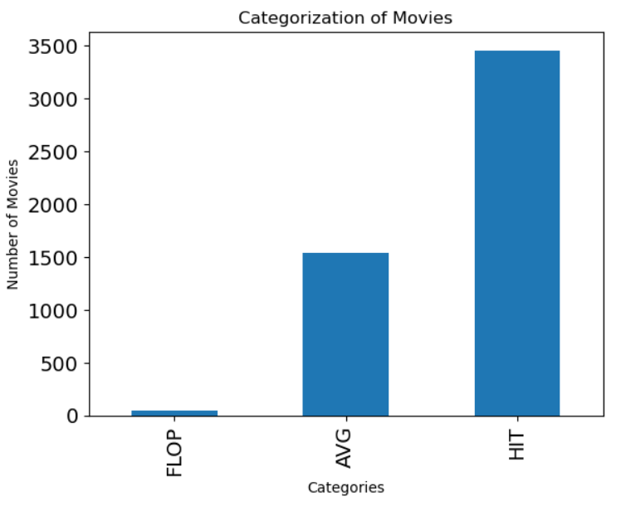
2. Categorizing the Target Variables:
Creating a new column Classify to categorize movies into "Hit", "Average", or "Flop" based on the IMDB score ranges(1-3 |-Flop Movie|,3-6 |- Average Movie,| 6-10 |- Hit Movie)
As seen in the graph there are a greater number of hit movies.
3. Handling Missing Values.
Dropping the samples which have missing values.
After dropping all the samples which have missing values, we are left with a clean data which has 3755 rows and 29 columns.
No column has been dropped.
We save the clean data as a separate csv file for making a dashboard.

Slide 9
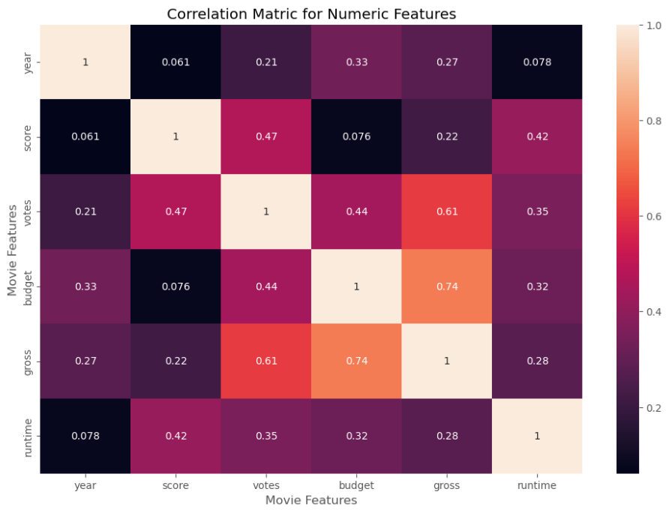
4. Label encoding
All the categorical columns are label encoded in this step.
5. Correlation
We have to find out if there is any relation between the columns. Multicollinearity cause errors to the prediction. Hence, we remove any multicollinearity. We also remove the column ‘imdb_score’ since we already have a column ‘classify’.

Slide 10
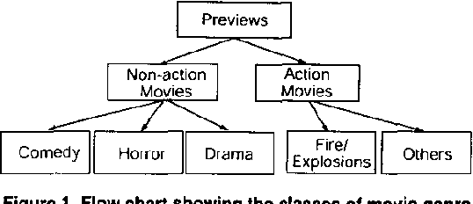
Classification Model Building
Classification is a supervised machine learning method where the model tries to predict the correct label of a given input data. In classification, the model is fully trained using the training data, and then it is evaluated on test data before being used to perform prediction on new unseen data.
Splitting the data into X and y where X contains Independent variables and y contain Target/Dependent variable.

Slide 11
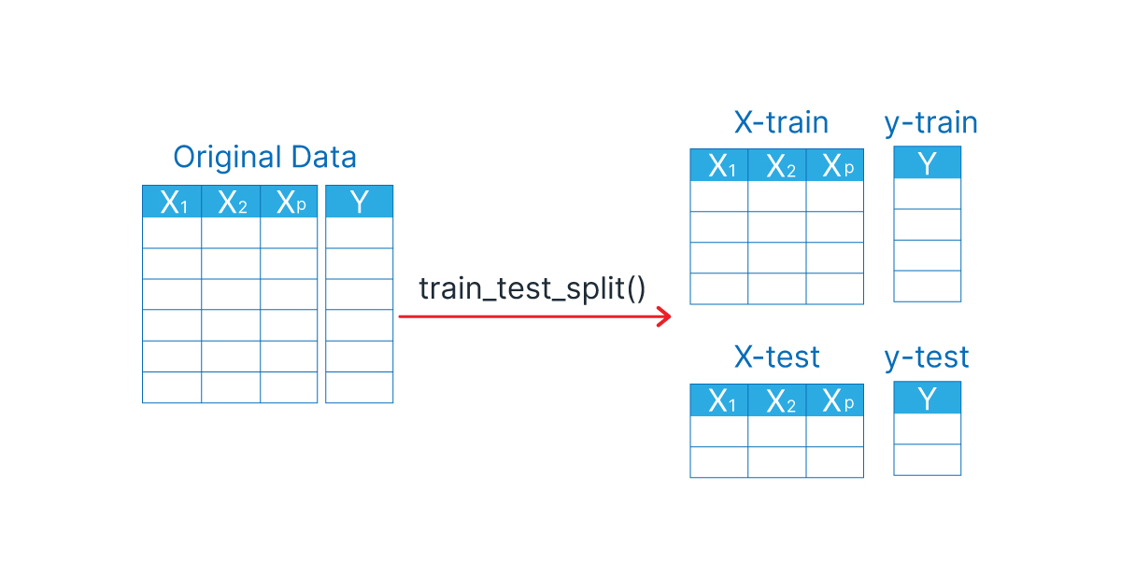
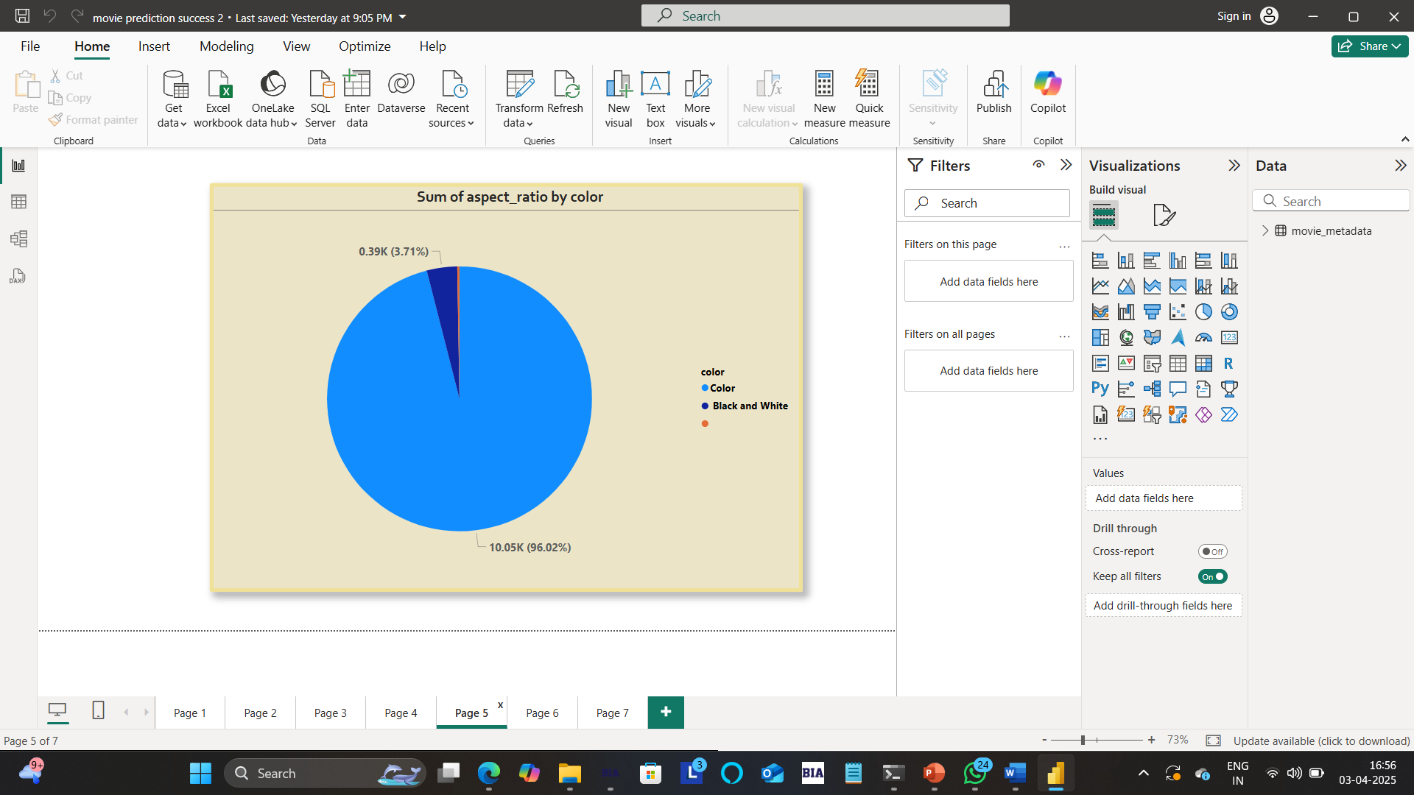
1. Train Test Split
We need data not only to train our model but also to test our model. So, splitting the dataset into 70:30 (Train:Test) ratio. We have a predefined function in Sklearn library called train_test_split, we use that.
2. Scaling
Few variables will be in the range of Millions and some in Tens, lets bring all of them into same scale

Slide 12
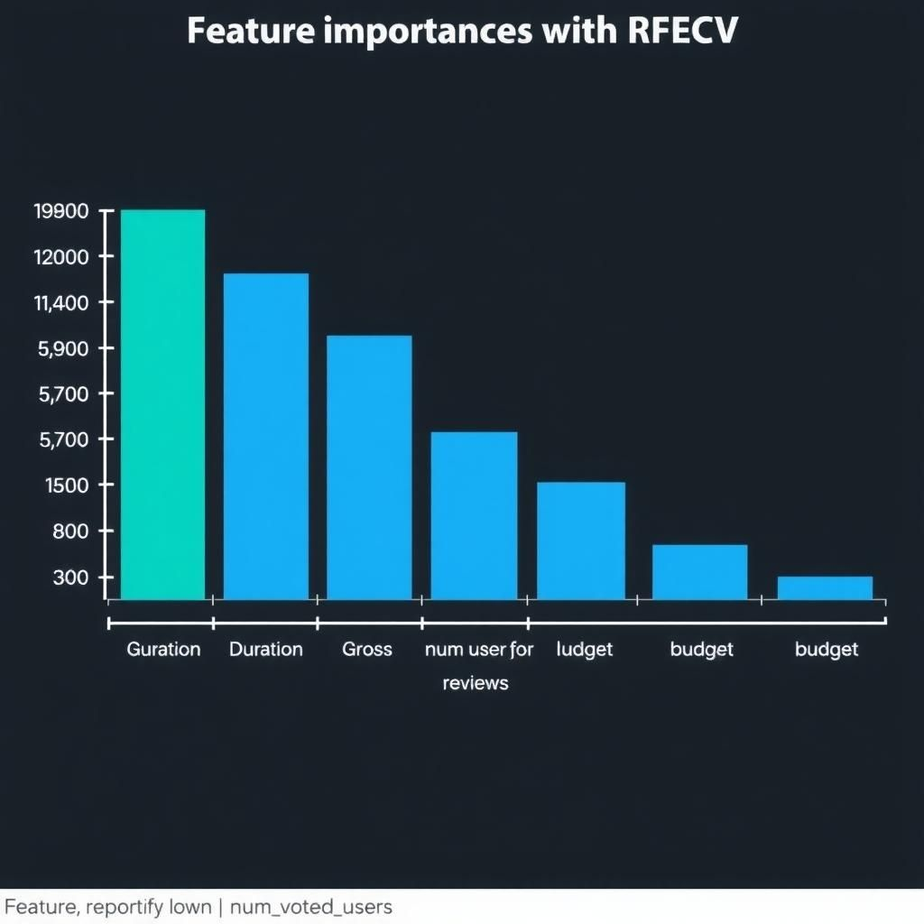
Feature Selection using RFECV

Slide 13

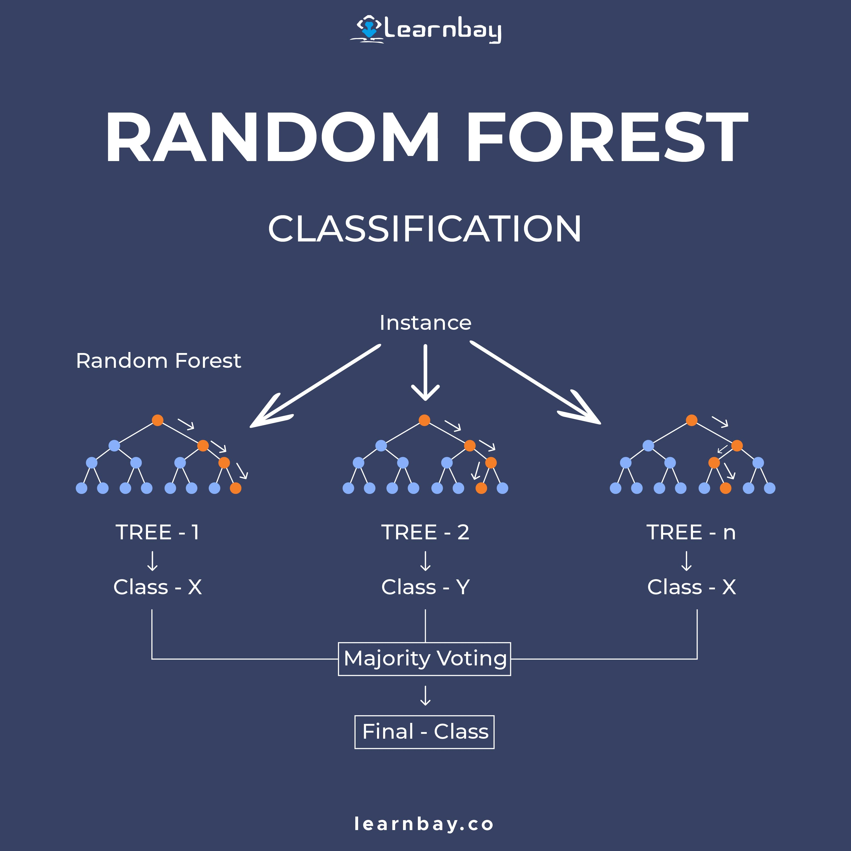
4. Random Forest
Random Forest is a classifier that contains a number of decision trees on various subsets of the given dataset and takes the average to improve the predictive accuracy of that dataset.
5. Confusion Matrix
A confusion matrix is a matrix that summarizes the performance of a machine learning model on a set of test data. It is a means of displaying the number of accurate and inaccurate instances based on the model’s predictions. It is often used to measure the performance of classification models, which aim to predict a categorical label for each input instance.

Slide 14
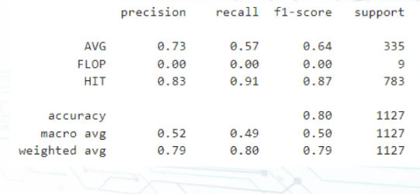
Classification Report
As Seen In The Classification Report. We Have An Accuracy Of 80% For This Model.

Slide 15
Questions ?

Slide 16
Thank You!

